Slide 1

Farmer city
City council meeting

Slide 2
surplus
ORDINANCE 1159
ORDINANCE DECLARING SURPLUS SPECIFIED PERSONAL PROPERTY OWNED BY THE CITY OF FARMER CITY
WHEREAS, the city of Farmer City has ownership of many pieces of personal property; and
WHEREAS, in the opinion of the corporate authorities of the city of Farmer City, it is no longer necessary or useful, or for the best interests of the city of Farmer City to retain ownership of the personal property hereinafter described; and
NOW, THEREFORE, BE IT ORDAINED by the city council of Farmer City as follows:
SECTION ONE: That the personal property is described as follows:
4 lifeguard floatation rescue tubes
8 office chairs
4 computer monitors
8 American flags
2017 Dodge Charger
Christmas decorations
Square drawer and stand
The recommendation is to have the Charger be sold via auction

Slide 3
Updates
Plum street is going well and remains on schedule at this point
Mauer-Stutz believes the Washington street replacement will be starting this week
Brush pick-up went well with good feedback from the community
EPA power plant required compliance reports have been successfully filed
EPA is requiring a power plant oil change
Met with Tabeling regarding the I-74 project – they are waiting on approval from IDOT and plan to have the road built before winter

Slide 4
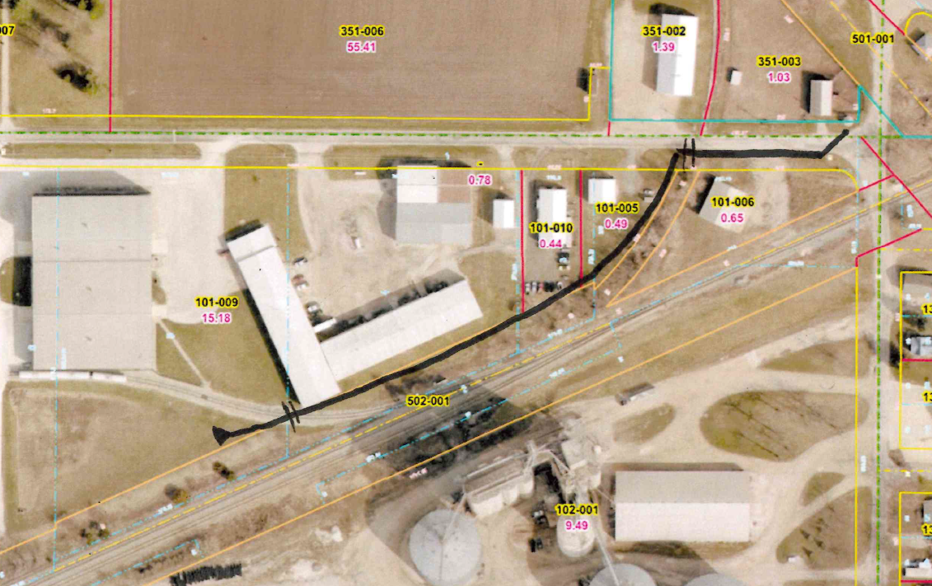
Depot & John drainage
City will vac out the grate
Attempt to run the city camera – some concern the camera will be too large
The bend has caused problems in the past
If the city camera is too big we will contract with a local camera company
We want the best assessment we can get if we have an issue here it could be a “quick” fix
If a quick does not work the black line shows a proposed new line – this would be a much bigger project requiring railroad approval

